Slide 1
Suez Canal University Faculty of Computer and informatics Name: Ahmed Mohamed eid Subject: Spotted Hyena Optimizer Algorithm

Slide 2
Spotted Hyena Optimizer
Spotted Hyena Optimizer is a metaheuristic bio-inspired optimization algorithm developed by Dhiman et al. [24,37,38]. The fundamental concept of this algorithm is to simulate the social behaviors of spotted hyenas.

Slide 3
Spotted Hyena Optimizer(cont.)
Spotted Hyena Optimizer for Solving Complex and Non-linear Constrained Engineering Problems.
The fundamental concept of this algorithm is the hunting strategy of spotted hyena in nature.
The main concept behind this algorithm is the social relationship between Spotted hyenas and their collaborative behavior.

Slide 4
There are four main steps of the SHO algorithm.
Encircling
Hunting
Attacking
Searching

Slide 5
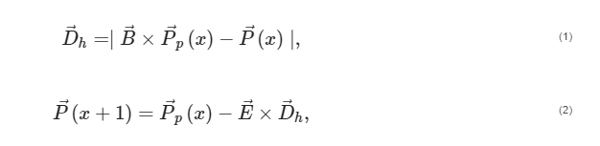
Encircling Prey
The target pray or objective is consider as a best solution and the other search agents can update their positions with respect to the best solution obtained.
The mathematical model of this behavior is represented by Equations (1) and (2):

Slide 6
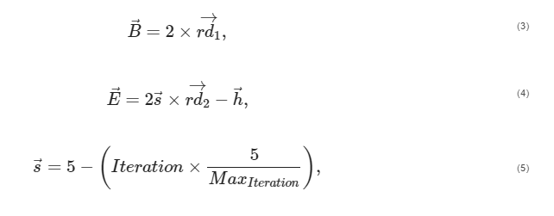
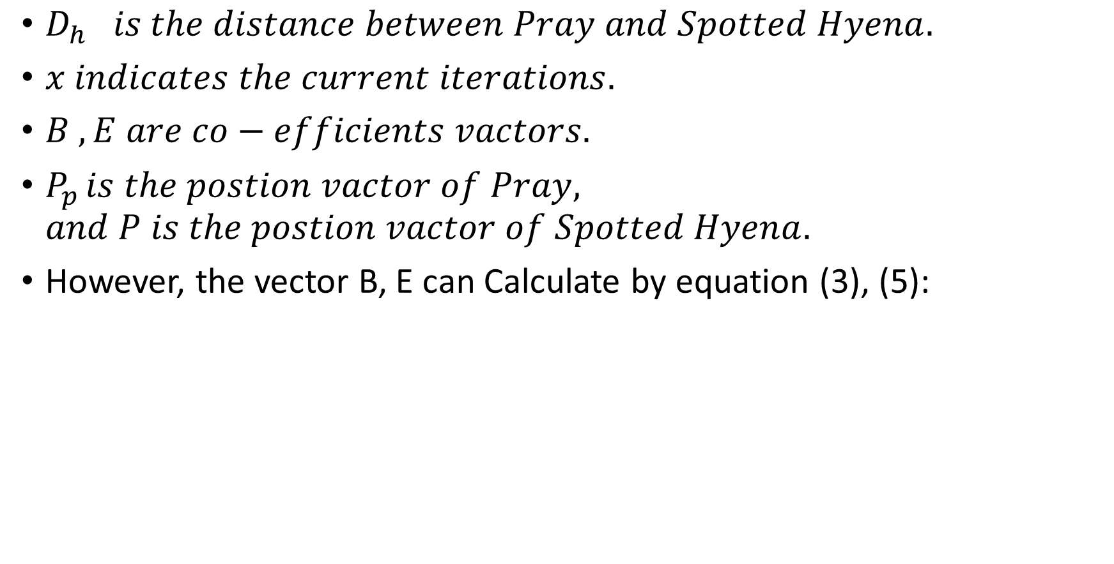
Encircling Prey(Cont.)
$D_{h} is the distance between Pray and Spotted Hyena.$
$x indicates the current iterations.$
$B , E are co−efficients vactors.$
$P_{p }is the postion vactor of Pray, and P is the postion vactor of Spotted Hyena.$
However, the vector B, E can Calculate by equation (3), (5):

Slide 7

Encircling Prey(Cont.)
Where $iteration 0, 1, 2,…, {Max}_{iteration}$
${}_{S}^{→} is linearly decreased from 5 to 0$
${}_{rd1}^{→} , {}_{rd2}^{→} are random vector in rage [0,1]$.

Slide 8
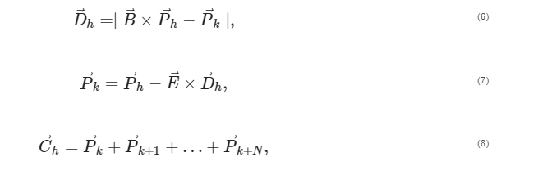
Hunting
The hunting strategy of the SHO algorithm is described by Equations (6)–(8):

Slide 9

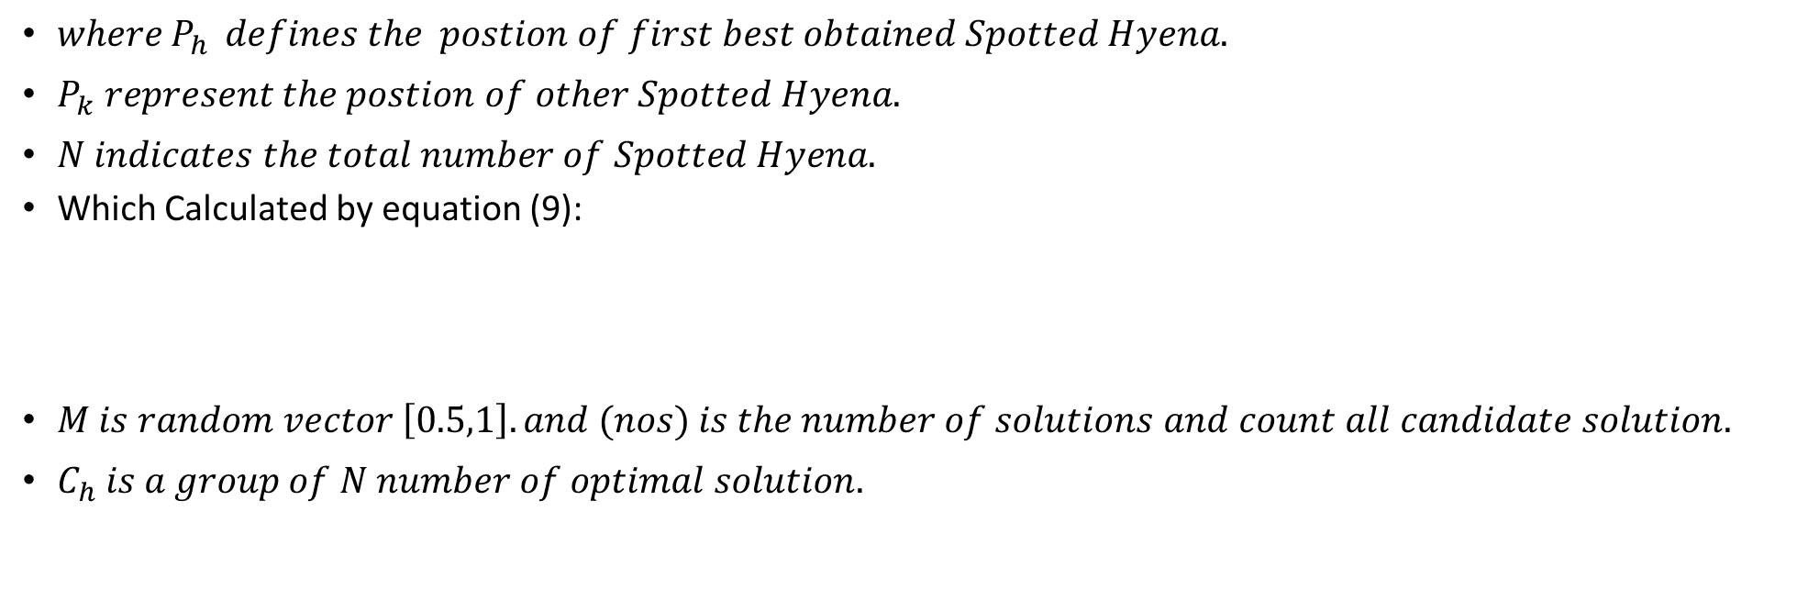
Hunting(Cont.)
$where P_{h } defines the postion of first best obtained Spotted Hyena.$
$P_{k} represent the postion of other Spotted Hyena.$
$N indicates the total number of Spotted Hyena.$
Which Calculated by equation (9):
$M is random vector \left[0.5,1\right].and {(nos)}_{ }is the number of solutions and count all candidate solution.$
$C_{h} is a group of N number of optimal solution.$

Slide 10

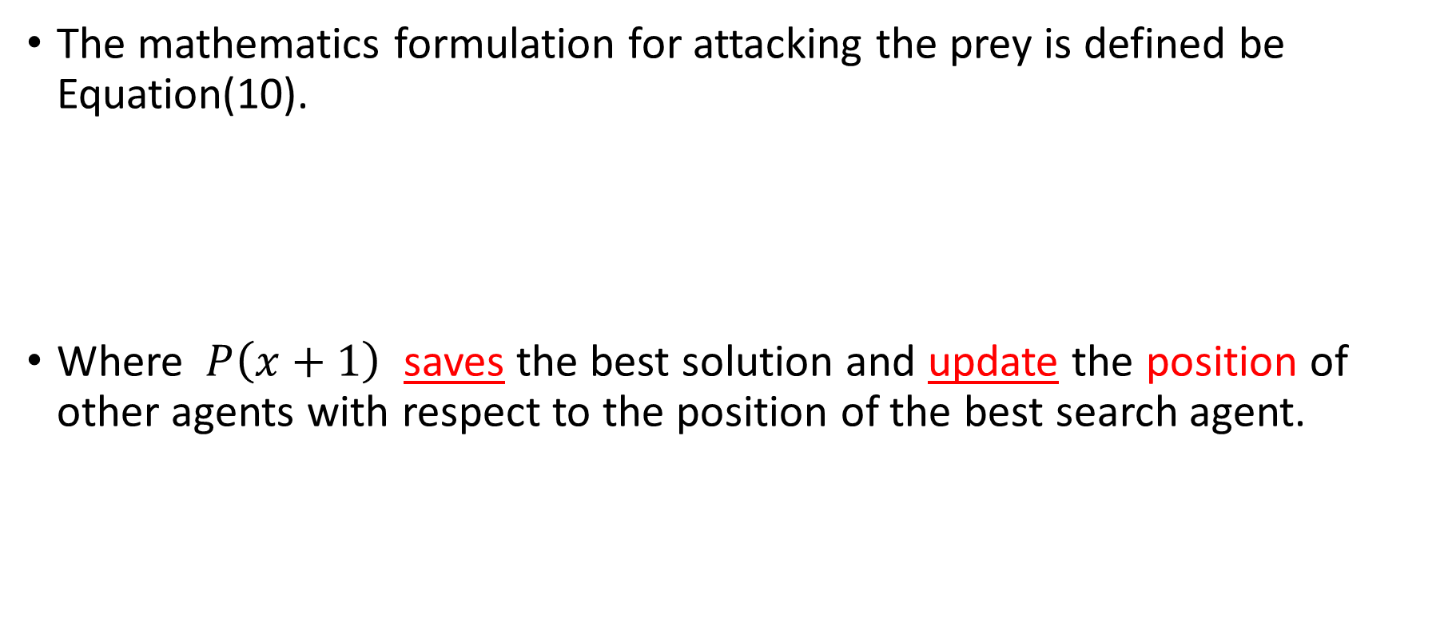
Attacking Prey
The mathematics formulation for attacking the prey is defined be Equation(10).
Where $P\left(x+1\right)$ saves the best solution and update the position of other agents with respect to the position of the best search agent.

Slide 11
Searching for Prey
The SHO algorithm solves various high dimensional problems with low computational efforts and avoids the local optimum problem.

Slide 12
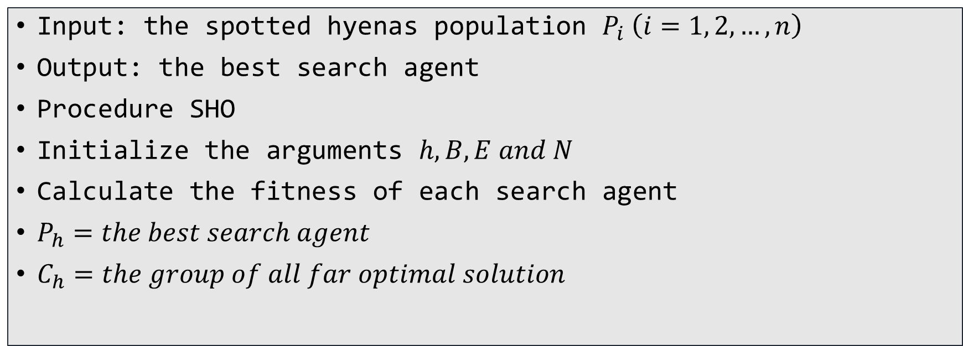
Algorithm Spotted Hyena Optimizer.
Input: the spotted hyenas population $P_{i} \left(i=1, 2,…,n\right)$
Output: the best search agent
Procedure SHO
Initialize the arguments $h, B, E and N$
Calculate the fitness of each search agent
$P_{h}=the best search agent$
$C_{h}=the group of all far optimal solution$

Slide 13
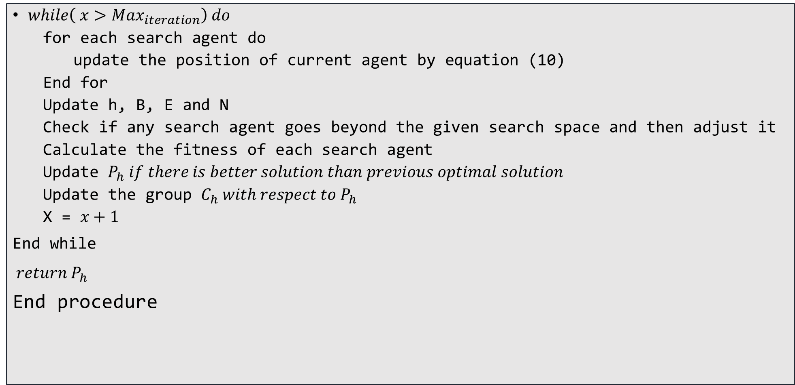
$while\left( x>Max_{iteration}\right) do$
for each search agent do
update the position of current agent by equation (10)
End for
Update h, B, E and N
Check if any search agent goes beyond the given search space and then adjust it
Calculate the fitness of each search agent
Update $P_{h} if there is better solution than previous optimal solution$
Update the group $C_{h} with respect to P_{h}$
X = $x+1$
End while
${return P}_{h}$
End procedure

Slide 14
This algorithm solve problem as:
Optical Buffer Design Problem
Airfoil Design Problem

Slide 15
Thank you.

